Slide 1

Emilia-Romagna Region
The National Contact Point of ITALY

Slide 2
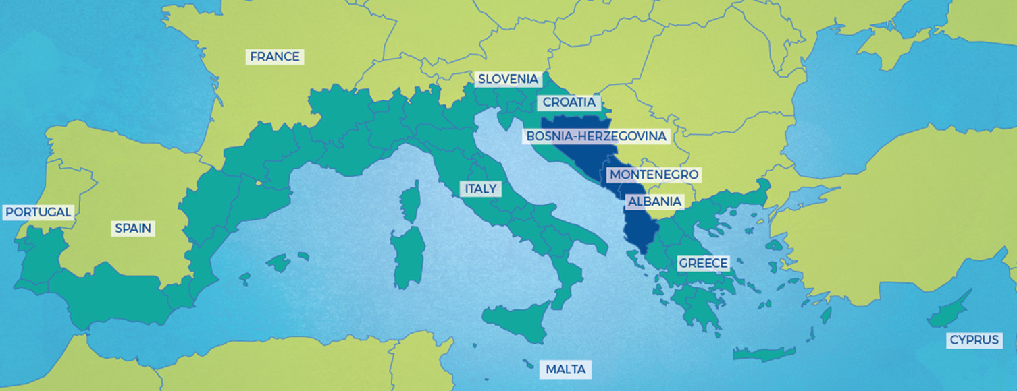
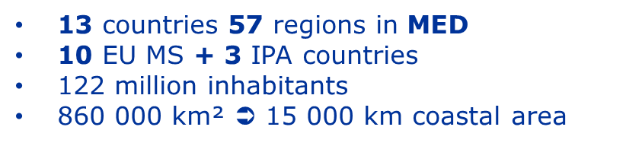

PROGRAMME AREA
Managing Authoritiy: RÉGION SUD - PROVENCE-ALPES-CÔTE D'AZUR (FR)
Notes:
Gibraltar

Slide 3




THE PROGRAMME’S PRIORITIES
The overall objective of the MED programme is to promote sustainable growth in the Mediterranean area by fostering innovative concepts and practices (technologies, governance, innovative services…), reasonable use of resources (energy, water, maritime resources…) and supporting social integration through integrated and territorially based cooperation approach.
PRIORITY AXIS 1:
Promoting Mediterranean innovation capacities to develop smart and sustainable growth
PRIORITY AXIS 2:
Fostering low carbon strategies and energy efficiency in specific MED territories: cities, islands and rural areas
PRIORITY AXIS 3:
Protecting and promoting Mediterranean natural and cultural resources
areas
PRIORITY AXIS 4:
Enhancing Mediterranean Governance

Slide 4







TYPES OF PROJECTS
Modular Projects
Horizontal Projects
Module 1 - STUDYING
Module 2 - TESTING
Module 3 - CAPITALISING
HP Green Growth
Facilitation
Results
2
Single Module
1
2/3
3
1/2
1/2/3
Combination of Modules
8 Specific Objectives >>
8 Thematic communities >>
8 Horizontal Projects

Slide 5



THE PROGRAMME ARCHITECTURE
3rd level impact
PLATFORM project
Mediterranean SHARED VISION on policies & actions
2nd level impact
HORIZONTAL projects
Thematic transnational communities
1st level impact
MODULAR projects
Local results
2
HP Green Growth
1
2/3
3
AXIS 4 - GOVERNANCE
HP Blue Growth
1/2
1/2/3
Facilitation
HP Social & Creative
Innovation
Results
exchanges
2
1
2/3
HP Efficient Buildings
3
1/2
1/2/3
HP Urban Transport
Low-carbon
economy
Facilitation
HP Renewable Energy
Results
exchanges
2
1
2/3
HP Sustainable Tourism
3
1/2
1/2/3
Natural/ cultural
Resources
HP Biodiversity Protection

Slide 6

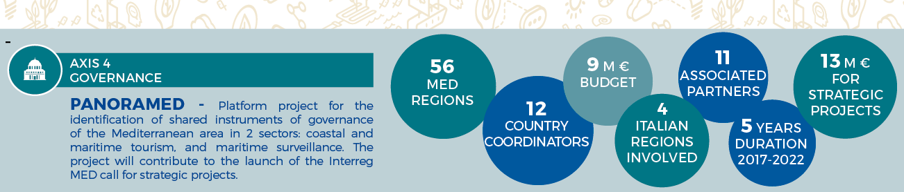
AXIS 4 – GOVERNANCE

Slide 7
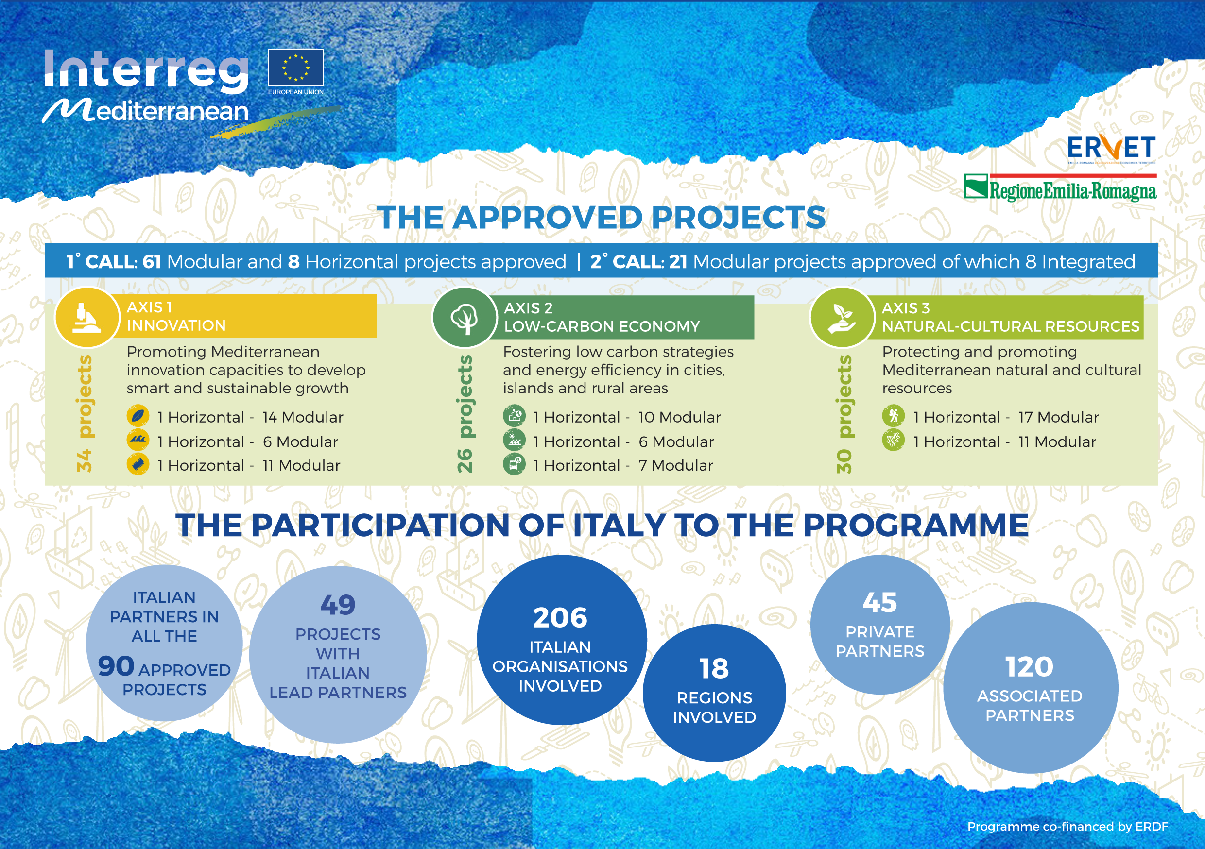

Slide 8
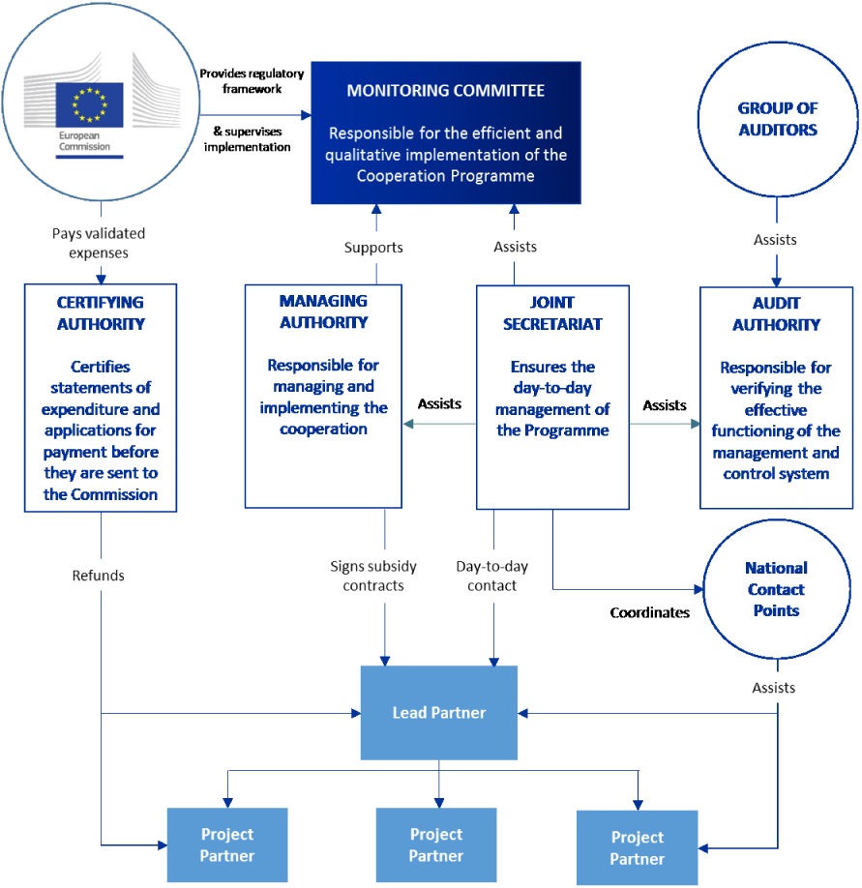
PROGRAMME MED 2014-2020:
RELEVANT AUTHORITIES AND BODIES
Location: Marseille (FR)
ROLES & RESPONSIBILITIES

Slide 9
ITALY: THE NATIONAL LEVEL MANAGEMENT
NATIONAL AUTHORITY
NATIONAL CONTACT POINT
ensures Italian coordination and participation in the Programme and defines the national positions that Italian representatives will have to present in the Monitoring Committee of the Programme
For 2014-2020, the Italian national coordination unit is composed of:
Council of Ministers, Department of Cohesion Policies - Presidency
Agency for Territorial Cohesion (ACT) - Co-Presidency
Emilia-Romagna Region – Co-Presidency
Abruzzo Region – Vice Presidency
provides information and workshops on the Programme, the calls for projects and administrative/technical requirements for the submission of applications (Synergie system)
assists and support LPs and PPs in the projects implementation
provides all the information on the procedures to obtain the approval of selected FLC and operation of the centralized system
provides insights about national regulation and requirements when the Programme invite partners to contact their National Authorities
contributes to the capitalization and mainstreaming of projects’ results
ensures transnationality of the Programme

Slide 10
Actions for involving the beneficiaries to the national capitalization process
NATIONAL CONTACT POINT of ITALY
THE COMMUNICATION PLAN
Activity 4
Assistance to Italian beneficiaries
Activity 7
Exchanges of best practices and experiences to be promoted in the Mediterranean area

Slide 11
Activity 4 - Assistance to Italian project beneficiaries_1
Objective
Organization of tailored information workshops for Lead Partners focused on the recorded needs and on the mainstreaming of projects results into national, regional and local programming.

Slide 12
Activity 4 - Assistance to Italian project beneficiaries_2
The planned activites:
2 national thematic technical workshops (2018-2020) addressed to LP and PP (Innovation, social entrepreneurship, other…)
4 territorially-based Focus Groups (2018-2019) addressed to LP and PP focused on mainstreaming
1 national event on mainstreaming (2019)
1 national event (2020) focused on a theme emerged from the analysis of the projects
1 final seminar (2021) focused on the results of the Italian participation to the Programme

Slide 13
Activity 7 - Exchanges of best practices and experiences to be promoted in the Mediterranean area
Organization of 2 joint seminars with the Managing Authorities and the National Committees of ADRION (2020) and Eni-CBC MED (2021), in order to facilitate the exchange of information between the Programmes, promote synergies and strengthen the capitalization of results.

Slide 14

Thank you for your attention!
Italian National Contact Point MED
medesk@regione.emilia-romagna.it

